Slide 1

GROUP 8
Duy Nguyen
Ji Yeol Yang
John Francavilla
Mojtaba Zadaskar

Slide 2
Is market-value a good indication of a teams performance?
Our team has taken a look into different soccer leagues around the world and analyzed the performance of teams and leagues.
Our working hypothesis is, the market-value of teams is a large factor in the overall performance of teams and leagues… More money = higher performance
By the end of this presentation we will have a response to this hypothesis

Slide 3

Routes

Slide 4
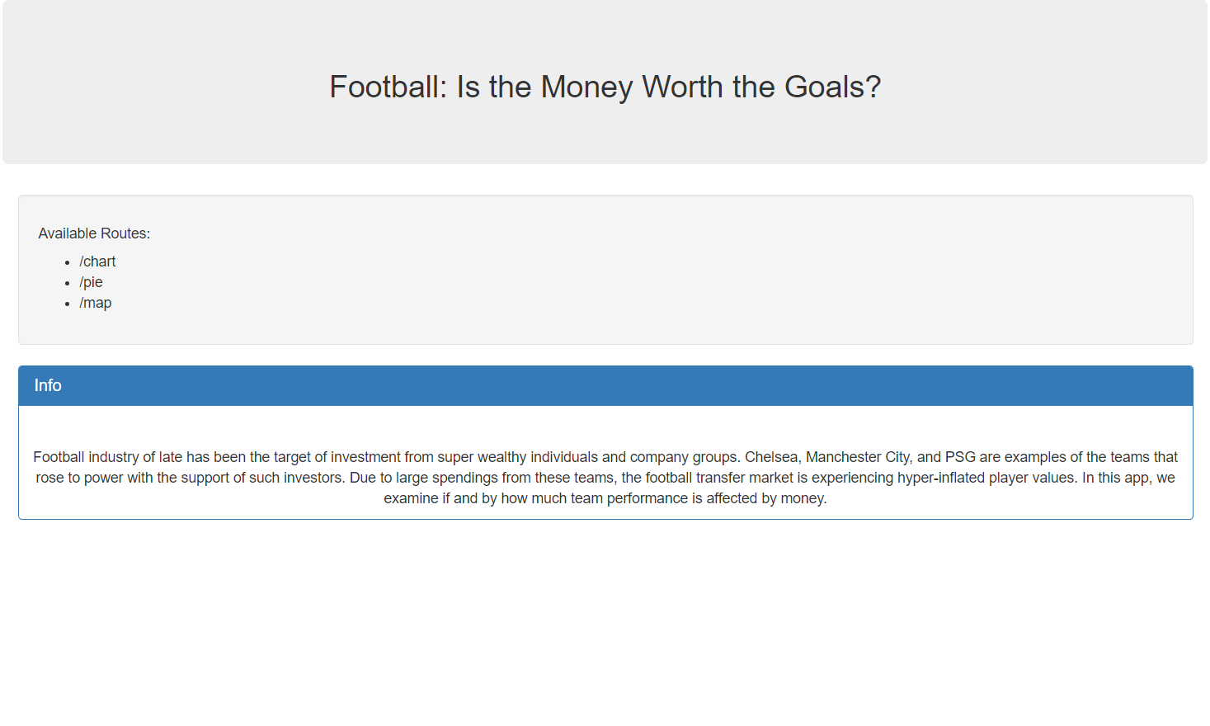
Routes
/
/jsondata
/map
/chart
/pie

Slide 5

jsondata
/jsondata

Slide 6
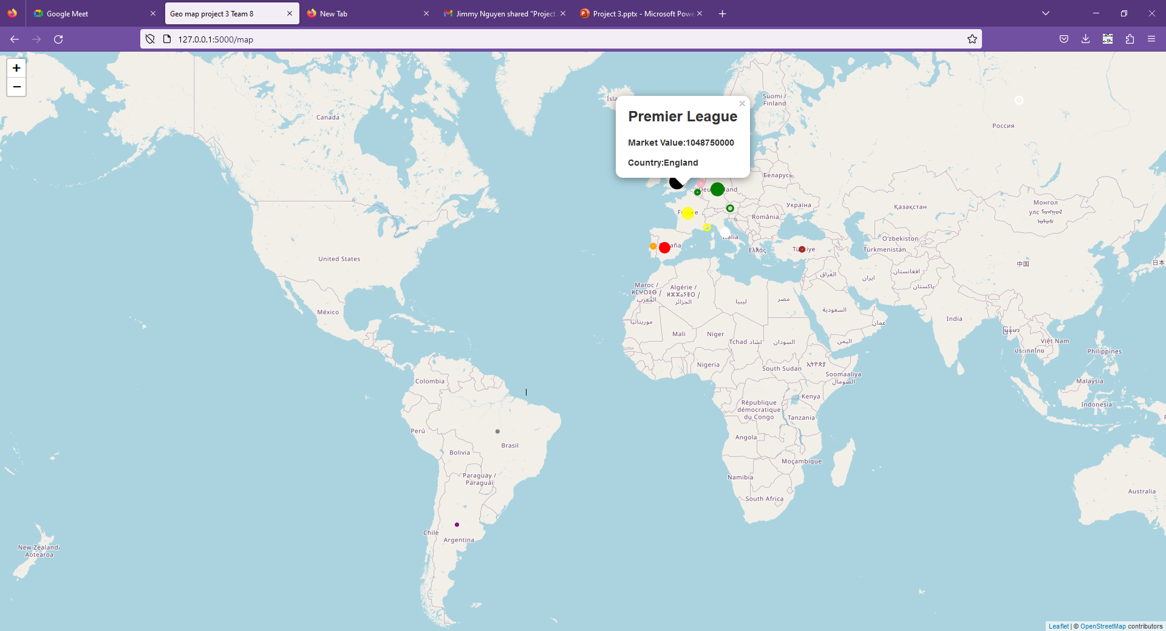
League’s Overview
12 leagues
Total Market Values:
$ 2,523,000,000
Highest :Premier League(England)
Lowest :Liga Profesional de Fútbol ( Argentina)

Slide 7
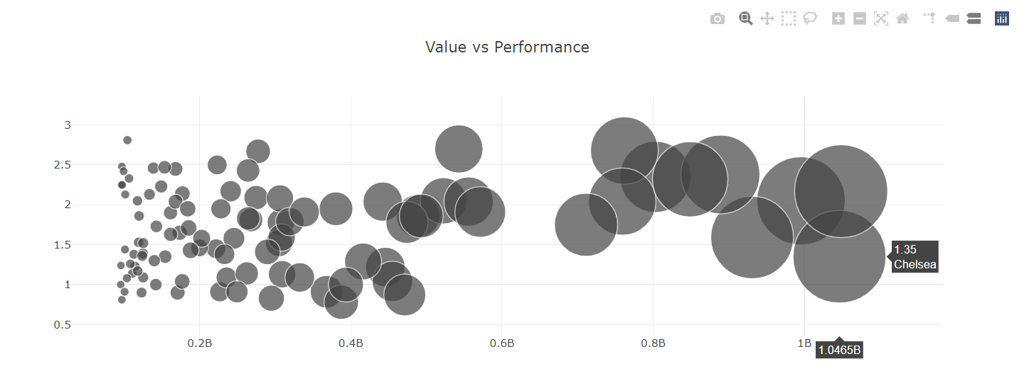
Team Performance
Avg points per match
Market value
Regardless of market value, team both have high and love points per match
Chelsea: 1.4B in market value yet low performance: 1.35
Between leagues: higher value team tends to perform better but not the main factor

Slide 8
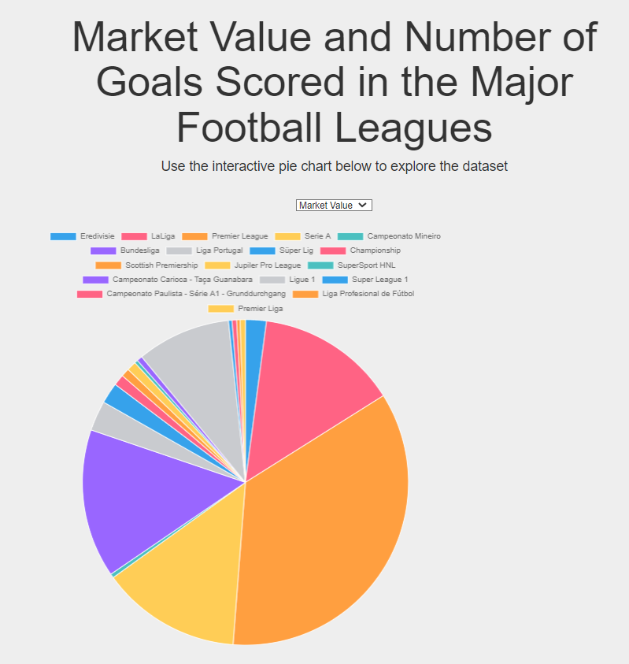
Market Share
The Big 5 Leagues
EPL, La Liga, Serie A, Bundesliga, Ligue 1
Make up the largest portion of the total market value

Slide 9
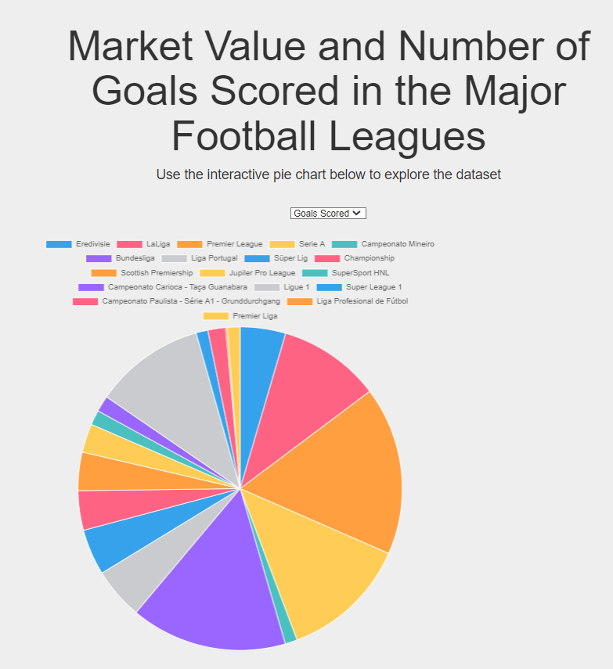
Pie Chart
Number of goals scored
Indicator assumption
Forwards are usually more expensive than Defenders
Big 5 Leagues more Goals Scored
Limitation

Slide 10
Is market-value a good indication of a teams performance?
Looking through the data we have found, the results are inconclusive towards confirming our original hypothesis.
While it is true that for some teams, the higher market-value correlates with high performance, it is not the case for all teams. In fact there are some teams with a market-value that is a fraction of the highest market-value but their performance does not falter.
With the studies we have done, the null hypothesis is satisfied. Market-value does not directly correlate to high performance. However, there are many more relationships to be looked at. More studies can be done to prove the original hypothesis.

Slide 11
THANK YOU

